Slide 1
welcome to crim!

Slide 2
Cleverness
Riches
Intelligence
Might
C

Slide 3
Intro
Text based adventure game, heavily inspired by Zork (one of my all-time favs).
1700 lines of code. 8 modules. About 40 hours of work.
Typical dungeon crawler, spiced up with easter eggs, humor, and plenty of obstacles to the player.
Some ASCII art implemented throughout to give a real retro-feel.

Slide 4
Gameplay
Player trying to collect four keys: green, white, blue, and black.
Each key obtained in a different way:
Intelligence Key – Obtained from a sphinx who tells a riddle
Riches Key – Sold by a greedy goblin for gold
Cleverness Key – Taken from a wizard who has a forcefield impenetrable by man.
Might Key – Pried from a dragon’s cold, dead claws.

Slide 5
Map
Created by a world function that assigns x and y coordinates to tiles
All tiles contain Intro_Text() and Modify_Player(), functions that are run within the game loop.
Dozens of tiles within the game.
Enemy tiles – contains enemies that attack the player
Item tiles – contains items that can be picked up by the player
Unique tiles – anything from riddles to a bar packed with dwarves

Slide 6
The Game Loop
Essentially just a huge while loop that does not end until player victory is achieved or lost.
Room intro text > room modify player > player action > loop starts over.
Tricky bit of coding, especially the **kwargs concept
Allows a function to be called with an unknown number of parameters.
Used in the do_action function since each actions takes a different amount of parameters.

Slide 7
Enemies Skeletons, Dragons, Rats, Oh my!
All enemies derived from an enemy base class.
Enemies have a number of attributes, most specifically damage, name, and hitpoints. Enemies can also attack and perform other actions
No enemies respawn.
All enemies slightly different from each other.
Some drop items, others drop keys.
Some even give you a beer.
Scattered throughout the map.

Slide 8
Items Because what else will you beat a rat to death with?
10 different items, all derived from an item base-class that contain name, description, and damage.
Weapon items. Highest damage, can be sharpened to do even more.
Sword
Greatsword
Potions. Modify the player somehow.
Healing potion – restores 50 hitpoints
Potion of Life – Brings the player back to life
Beer – Hurts the player 3 hitpoints
Money – used to buy healing potions throughout the game, along with obtain the green key.

Slide 9
Actions
The player can actually do things!
Each action is unique and requires different code.
Some actions modify the player’s inventory, others modify an enemy, others modify the room.
All stored in an action module
Accessed using a hotkey.
Available actions function find and displays the actions available for each room.
Combat
Damage found using an algorithm involving the random module.
Player can only fight, flee, or heal while in combat.

Slide 10
Guide
Extensive guide that details all aspects of CRIM.
Covers everything from enemies to items to actions.
Also provides the fastest way to beat CRIM
Primarily used for testing purposes, the player is encouraged to learn about the game on their own.
Contains a color-coded map of tiles.

Slide 11
Testing Squash ALL the bugs!
Played myself several dozen times, trying out every possibility.
Played by several of my friends without my guidance, followed by a QnA session afterwards.
Offered up found bugs, glitches, and suggestions.
Helped to improve understandability of CRIM, and also helped me realize some bugs I had missed before.
Implemented most of their advice.

Slide 12
Finishing Up
Added a credits function to display who helped me out.
Changed some rooms so there is less repetition of tiles.
Inserted more opportunities to get coins.
Possibly add a few more monsters scattered throughout.
Turn in project and pray!

Slide 13
Finishing Up
Added a credits function to display who helped me out.
Changed some rooms so there is less repetition of tiles.
Inserted more opportunities to get coins.
Possibly add a few more monsters scattered throughout.
Turn in project and pray!

Slide 14
Finishing Up
Added a credits function to display who helped me out.
Changed some rooms so there is less repetition of tiles.
Inserted more opportunities to get coins.
Possibly add a few more monsters scattered throughout.
Turn in project and pray!

Slide 15
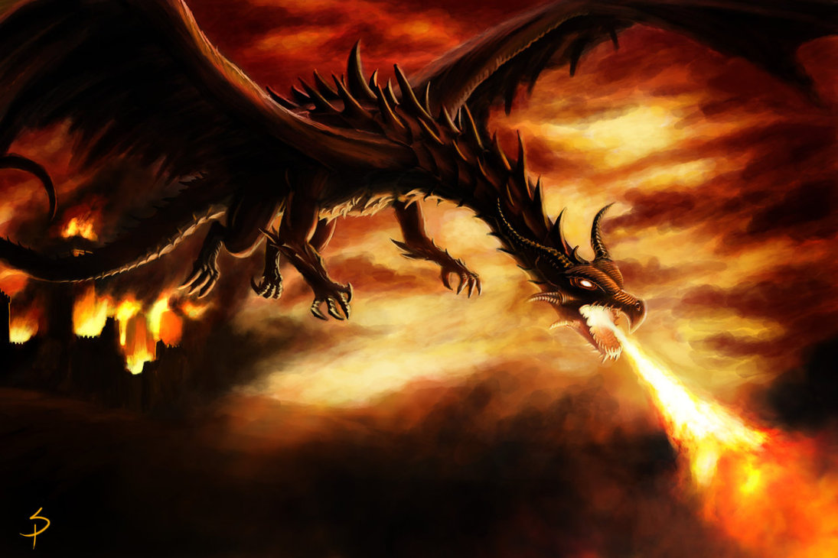
Thanks for playing!

